Slide 1

Name: Faris Iskandar bin Abd Rahman
No Matriks: S62371
Project Name: Campus Marketplace Application

Slide 2
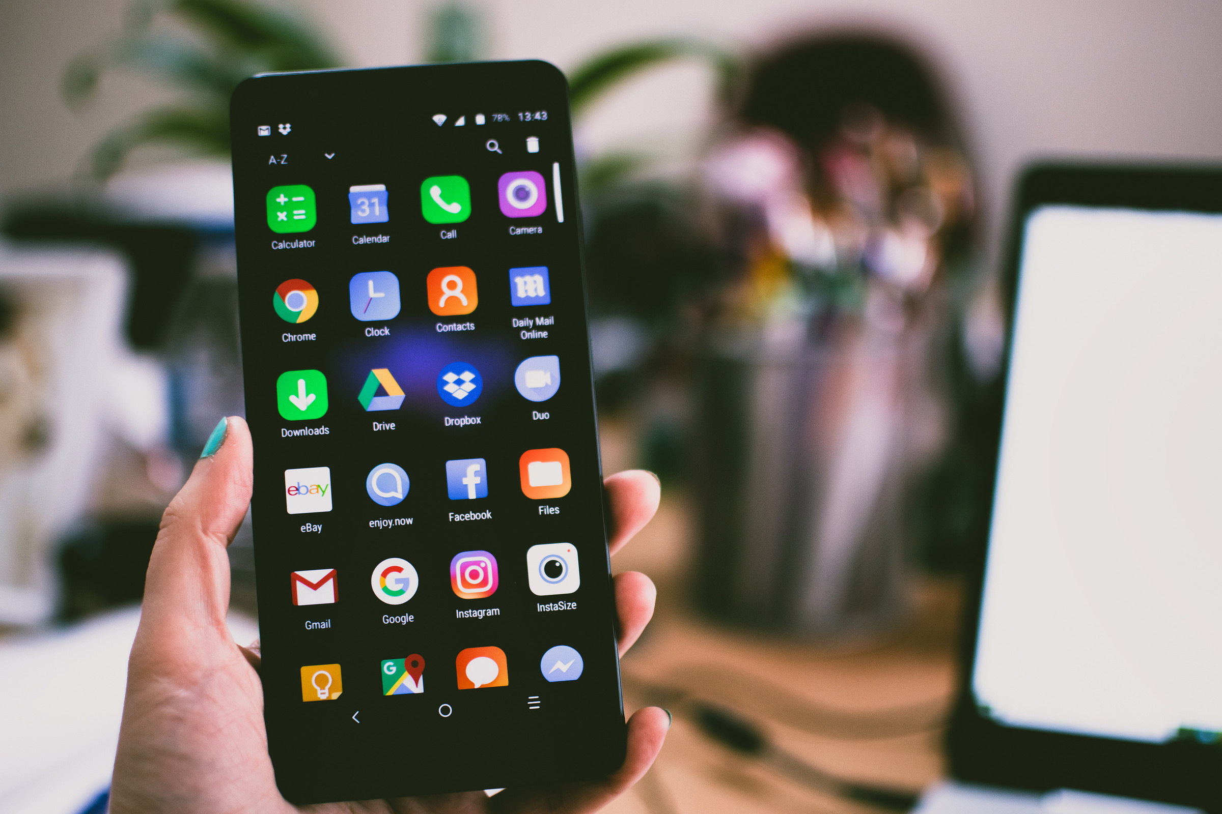
What is Campus Marketplace Application?
Selling Daily Stuff
Online Purchase

Slide 3

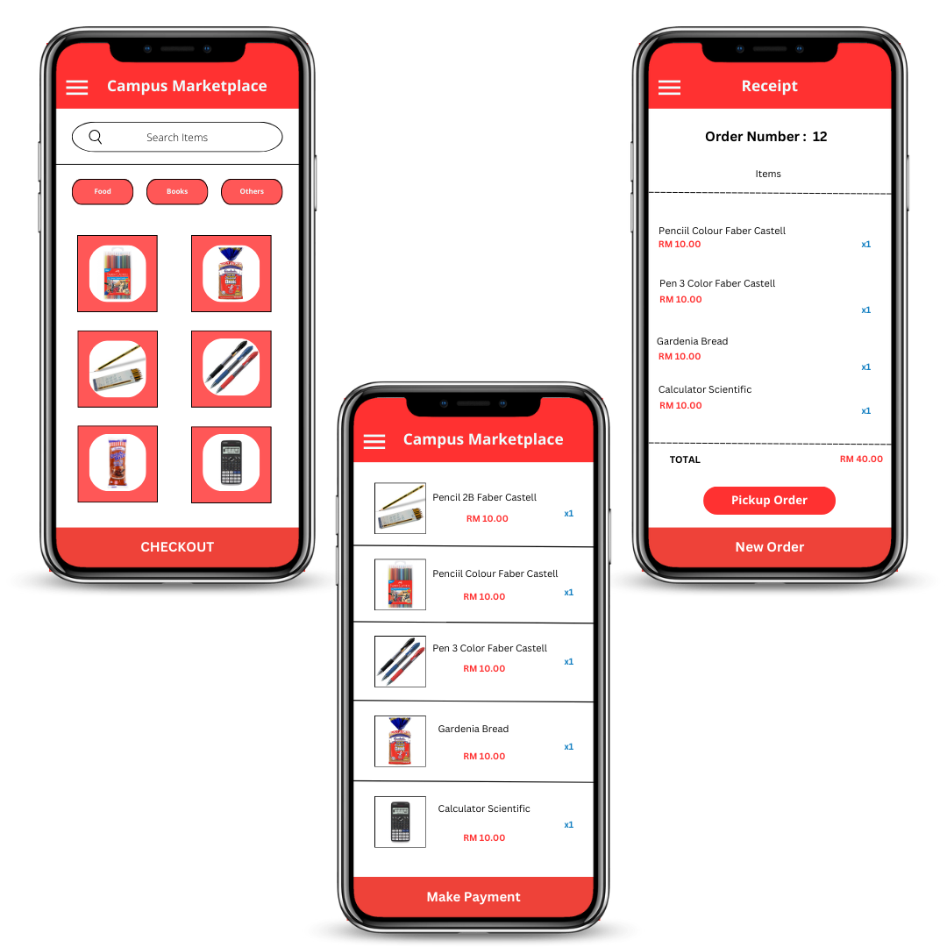
PROTOTYPE DESIGN
Home Page
Payment Page
Show Receipt page

Slide 4
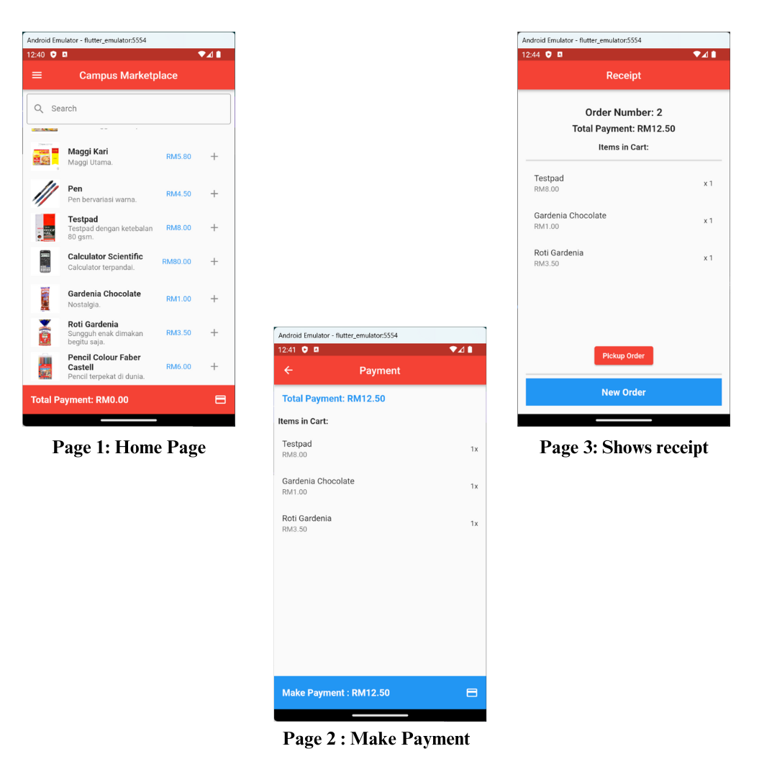
UI OF PROTOTYPE
Home Page
Payment Page
Show Receipt page

Slide 5
REFERENCE
Paramasivan, K., & Amrita, M. (2020). Development of mobile application for product pricing. ResearchGate. https://www.researchgate.net/publication/344133758_Development_of_Mobile_Application_for_Product_Pricing
Nah, F. F., Siau, K., & Sheng, H. (2005). The value of mobile applications. Communications of the ACM, 48(2), 85–90. https://doi.org/10.1145/1042091.1042095
Napoli, M. L. (2019). Beginning flutter: A Hands On Guide to App Development. John Wiley & Sons.

